Slide 1
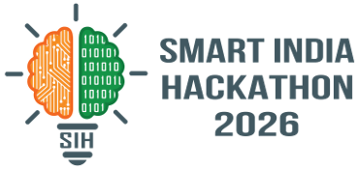

SMART INDIA HACKATHON 2026
TEAM CALYX
Problem Statement ID: SIH26131
Problem Statement Title: Early detection and
management of crop diseases and pest infestations
Theme:Agriculture, FoodTech & Rural Development
PS Category- Software/Hardware: Software
Team ID-
Team Name(Registered on portal)-

Slide 2

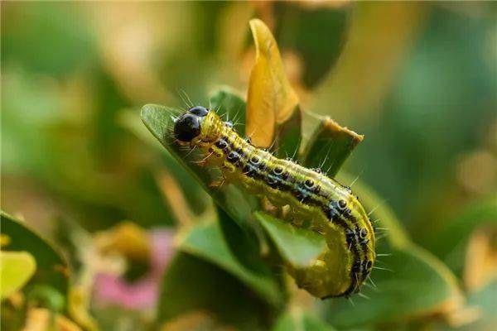
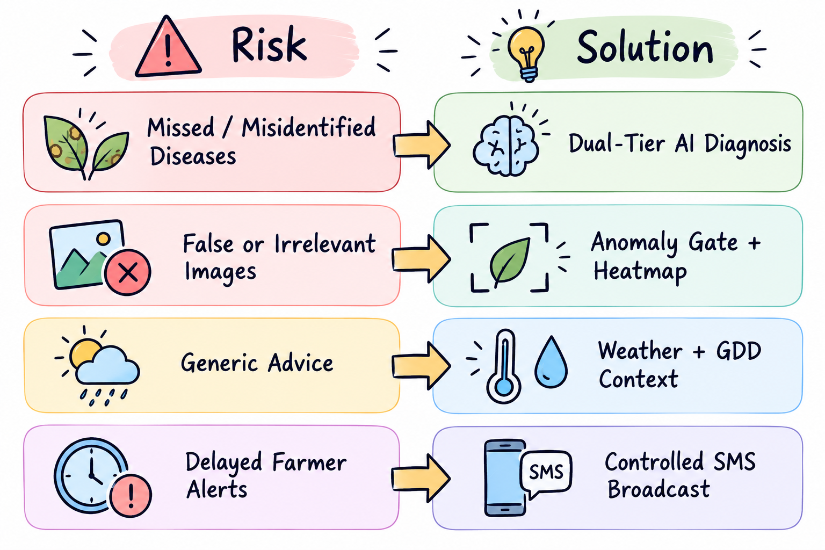
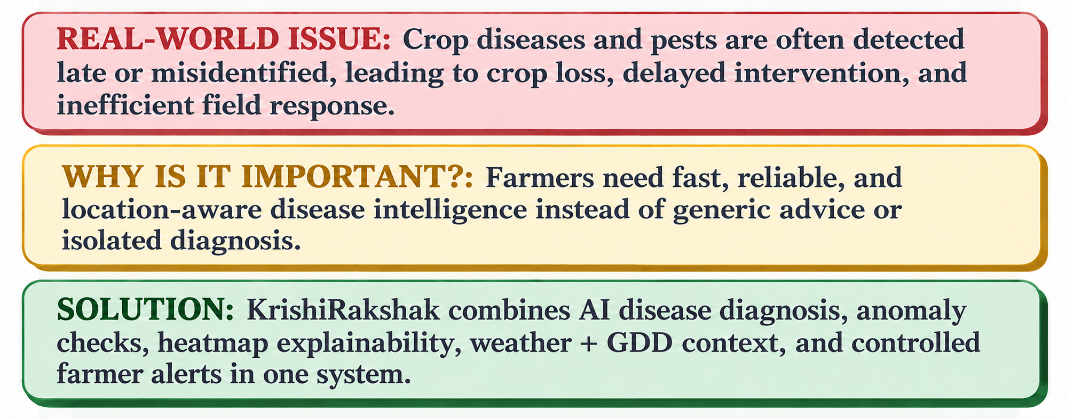
KRISHI RAKSHAK
Proposed Solution
WHAT IT IS
Software-only AI diagnosis + Genetic advisory platform for Early Pest Detection.
THREE CORE MODULES
1. Biology + Genetics Advisory: Weather-based risk prediction + resistance-gene data. Flags documented Bt resistance and recommends IPM/biocontrol.
2. AI Visual Engine: Instant leaf/boll image diagnosis via transfer learning.
3. Community Alert Layer: Geotagged reports trigger SMS alerts and a district-level outbreak heatmap.
THREE-TIER ACCESS MODEL
• Smartphone: App with photo upload
• Feature Phone: Multilingual SMS Alerts
• No Personal Phone: CSC/KVK walk-in, operator submits on farmer's behalf

Slide 3
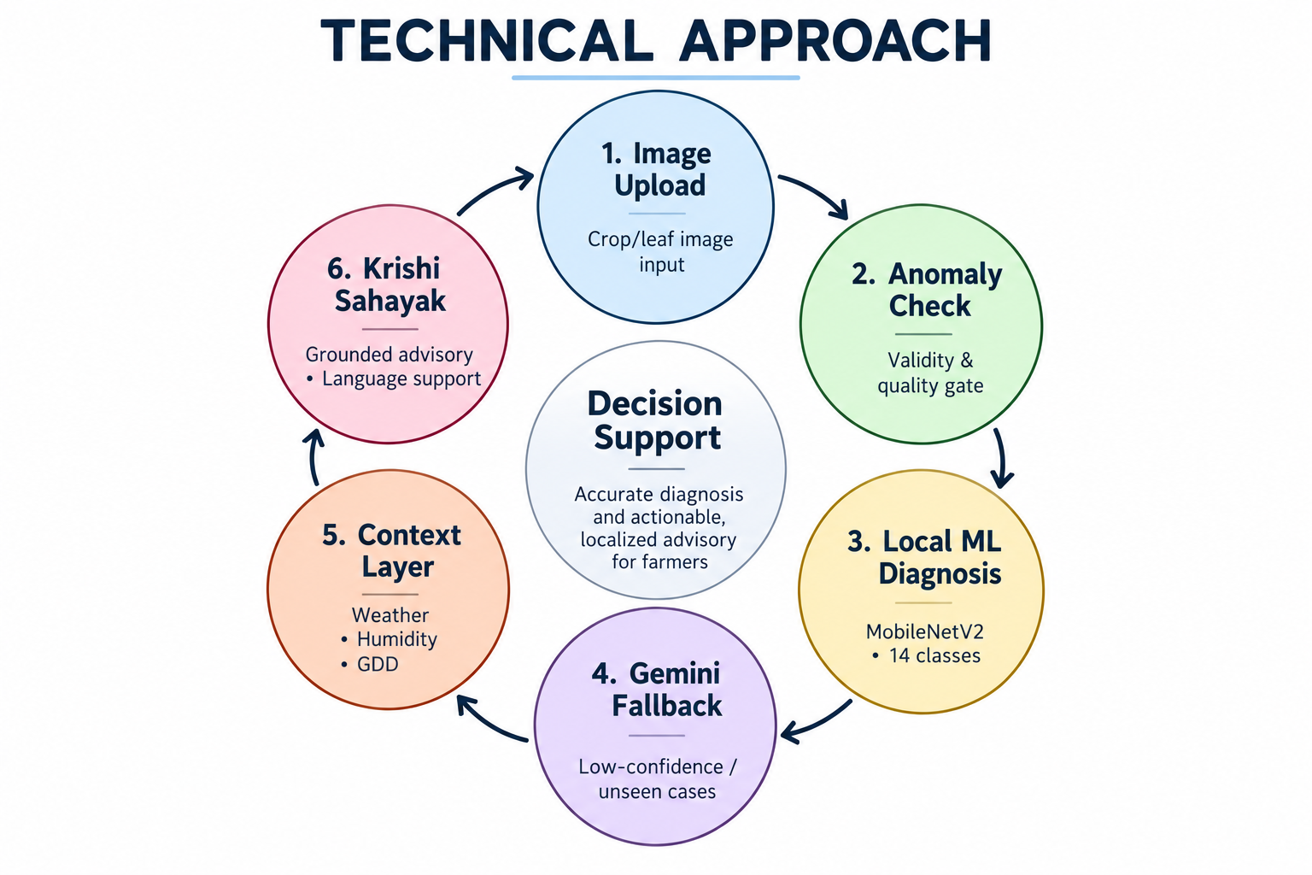
TECHNICAL APPROACH
visibility Computer Vision Model
•PyTorch MobileNetV2 backbone
•AI driven diagnosis(Google Gemini)
• Fine-tuned on 14-class Cotton + Paddy dataset
• 224×224 input, ImageNet normalization
• Weights cached via @st.cache_resource
thermostat Weather & Risk Engine
• Open-Meteo live microclimate API
• Temperature, humidity, Growing Degree Days
• Outbreak-risk threshold screening
• Works for any location across India
notifications_active Alerting & Directory
• Registered farmer directory
• One-click DLT-compliant SMS dispatch
• Outbreak clustering + template builder
• Auto-suppressed for healthy detections
layers Application Layer
• Single Streamlit interface (app.py)
• Ties inference, weather, and alerts together
• Up to 9 Regional Languages included
• Low-bandwidth optimized for rural use

Slide 4
FEASIBILITY AND VIABILITY
memory TECHNICAL
payments ECONOMIC
smartphone OPERATIONAL
trending_up VIABILITY
Technical Feasibility
MobileNetV2 image classification
PyTorch training and inference
Streamlit for rapid deployment
AI driven diagnosis using Flash 2.5
Modular Python architecture
Economic Feasibility
Open-source, low compute cost
Lightweight model, low infra
Low-cost cloud/local deploy
Scalable, no major hardware
Operational Feasibility
Simple smartphone workflow
Built for farmers & officers
Multilingual support
Minimal technical training
Long-term Viability
Newer and Better API keys
Satellite imaging
Add more crops and classes
Expand district and state-wise
Extend weather & surveillance
Integrate with govt platforms

Slide 5
FEASIBILITY AND VIABILITY
memory TECHNICAL
payments ECONOMIC
smartphone OPERATIONAL
trending_up VIABILITY
Technical Feasibility
MobileNetV2 image classification
PyTorch training and inference
Streamlit for rapid deployment
AI driven diagnosis using Flash 2.5
Modular Python architecture
Economic Feasibility
Open-source, low compute cost
Lightweight model, low infra
Low-cost cloud/local deploy
Scalable, no major hardware
Operational Feasibility
Simple smartphone workflow
Built for farmers & officers
Multilingual support
Minimal technical training
Long-term Viability
Newer and Better API keys
Satellite imaging
Add more crops and classes
Expand district and state-wise
Extend weather & surveillance
Integrate with govt platforms

Slide 6

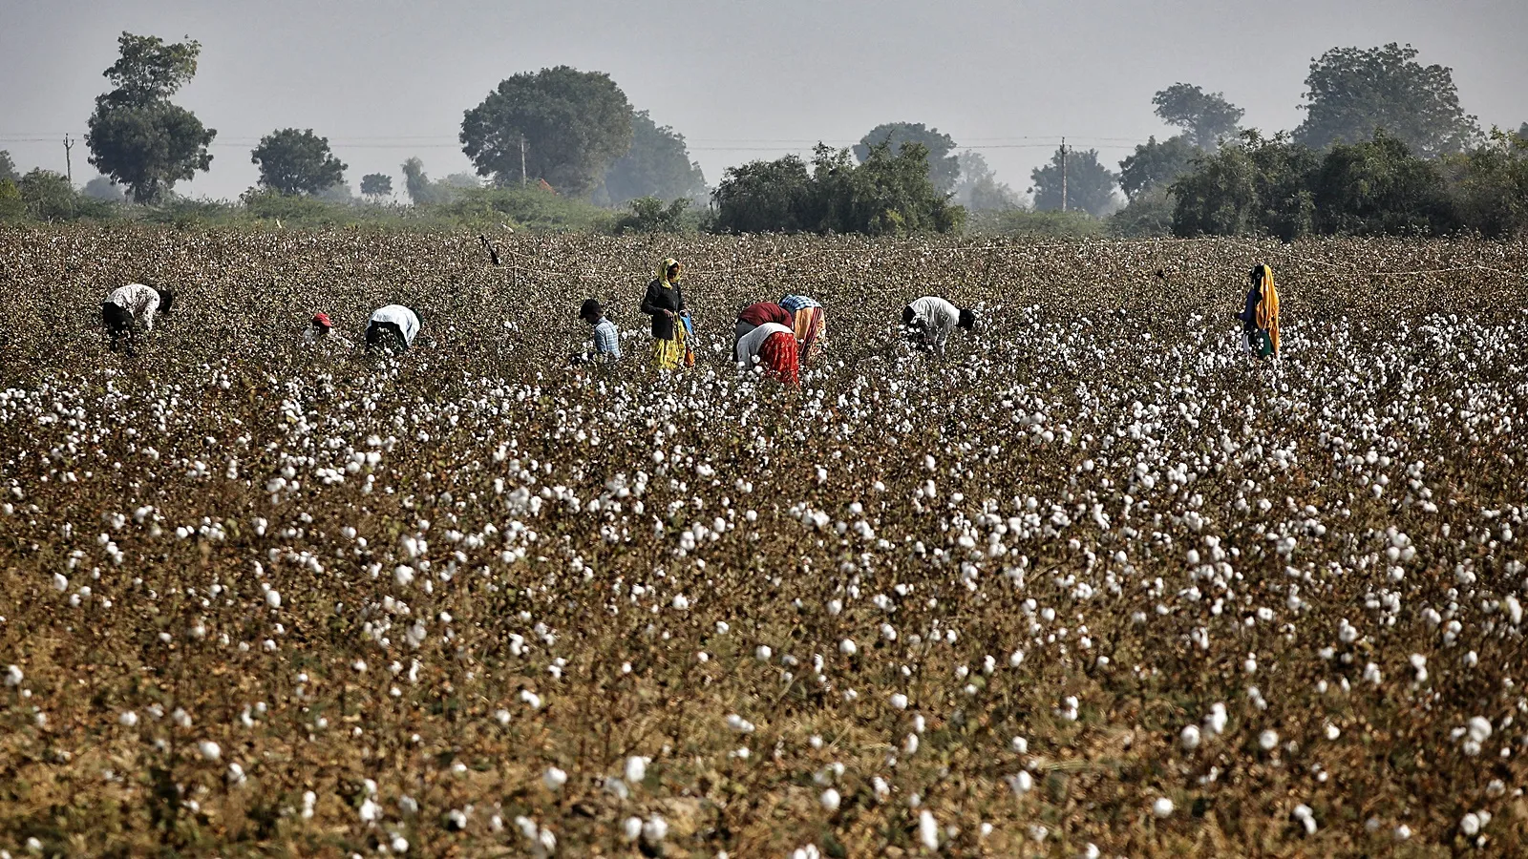
IMPACT AND BENEFITS
1. FARMER IMPACT
2. AGRICULTURAL IMPACT
Provides timely, accurate, localized insights
Reduces uncertainty in crop & soil decisions
Low-cost & easy-to-use solution for all
Empowers farmers with data-driven guidance
Increases confidence & improves productivity
Enables precision farming & crop planning
Optimizes water, fertilizer, & resource use
Improves soil health and crop yield
Supports early detection of issues & risks
Promotes sustainable, climate-resilient farming
4. COMMUNITY IMPACT
3. ECONOMIC & ENVIRONMENTAL
Strengthens knowledge sharing & collaboration
Encourages youth & agri-innovation
Creates awareness on sustainable practices
Supports rural development & self-reliance
Builds an empowered farming community
Promotes Unity amongst the community
Increases farm income & reduces input costs
Minimizes crop losses & enhances profit
Reduces chemical usage & pollution
Conserves water & promotes efficiency
Supports sustainable agriculture & growth

Slide 7
TEAM MEMBERS
 | Name | Reg. No. | Dept. | Year of Study | Semester | Gender | Email id | Mobile no.
Team Leader | Harshita Banthia | RA2411009010016 | Biotechnology | 3 | 5 | Female | hb5886@srmist.edu.in | 8240554437
Team Member | Kunsh Billa | RA2411037010079 | Genetic engineering | 3 | 5 | Male | kb1230@srmist.edu.in | 7032233830
Team Member | Shreyas Nigam | RA2411070010009 | Genetic engineering | 3 | 5 | Male | sn9331@srmist.edu.in | 9352396511
Team Member | Shreyan Shinde | RA2411037010085 | Genetic engineering | 3 | 5 | Male | ss2222@srmist.edu.in | 9360792103
Team Member | Garvit Gupta | RA2311036010031 | Biotechnology w/s in regenerative medicine. | 4 | 7 | Male | gg0268@srmist.edu.in | 7340136637
Team Member | Manas Lute | RA2411009010030 | Biotechnology | 3 | 5 | Male | ml1649@srmist.edu.in | 7877477325
Faculty Mentor (Mandatory) | Dr. Y Nikhileshwar Reddy | 103715 | Bioengineering | NA | NA | Male | nikhiley@srmist.edu.in | 9000111412
Industry Mentor (Mandatory) | Tejas Rajagopal | NA | Machine learning | NA | NA | Male | tejasr112002@gmail.com | 6381266918

Slide 8
RESEARCH AND REFERENCES
Nagrare, V. et al. (2025). Resistance development in pink bollworm against Bt cotton, Reports doi: 10.1038/s41598-025-89575-z
Fand, B.B. et al. (2019). Widespread infestation of pink bollworm on Bt cotton in Central India . https://doi.org/10.1016/j.cropro.2025.107257
Mohanty,S.P.,Hughes,D.P.,Salathé,M (2016).Using Deep Learning for Image-Based Plant Disease Detection,Frontiers in Plant Science doi: 10.3389/fpls.2016.01419
Woo, S.L. et al. (2020). Trichoderma: The "Secrets" of a Multitalented Biocontrol Agent, Plants (MDPI), DOI: 10.3390/plants9060762.
Impressive Times (2026). Common Service Centres Cross 5 Lakh Mark Under Digital India
https://data.mendeley.com/datasets/y5hwbhrn5m/1

